Slide 1

Energy and Environmental Engineering CEME 102
Dr. Kamlesh Sorate
Assistant Professor, MED
SVNIT Surat

Slide 2
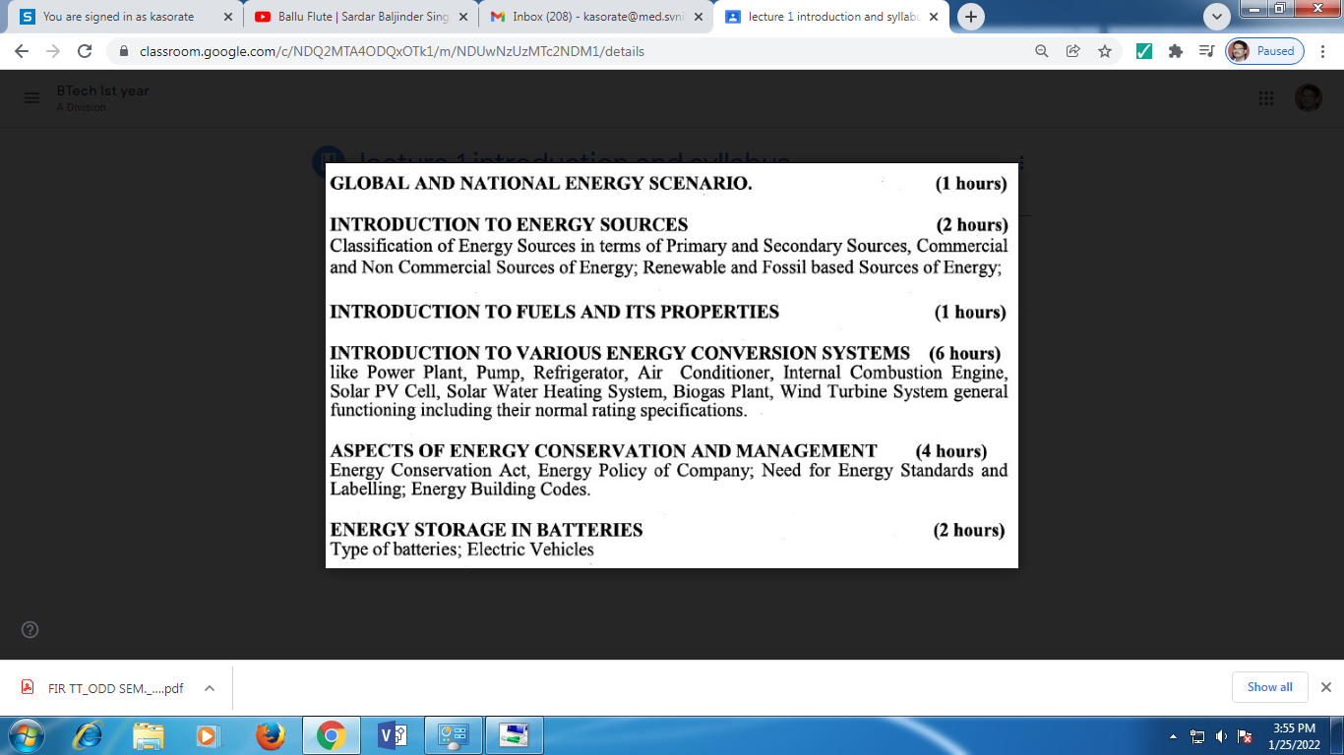

Slide 3
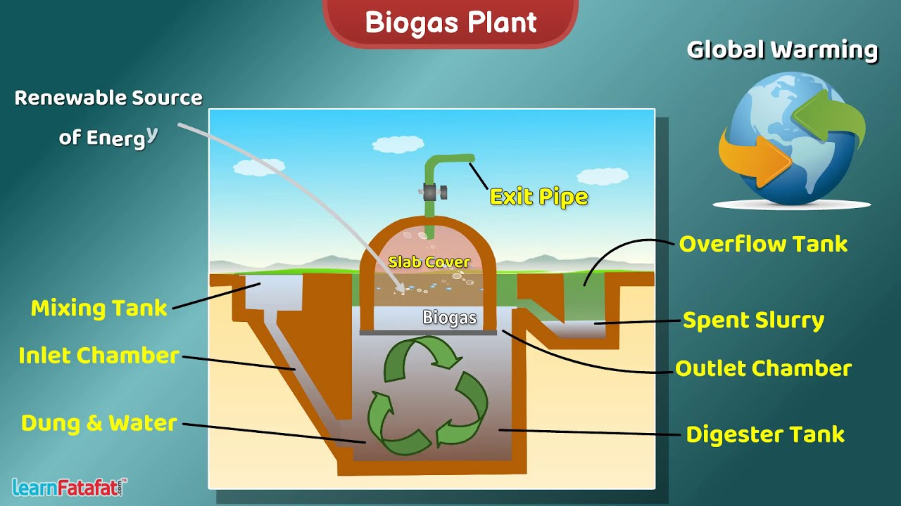

Slide 4
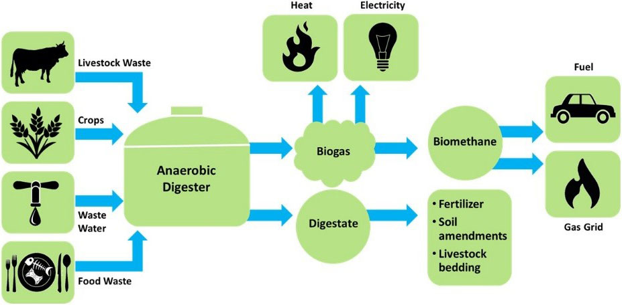

Slide 5
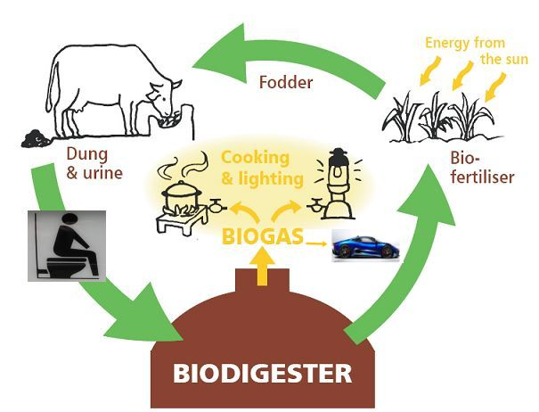
Biogas circular economy
Notes:
Biogas circular economy

Slide 6
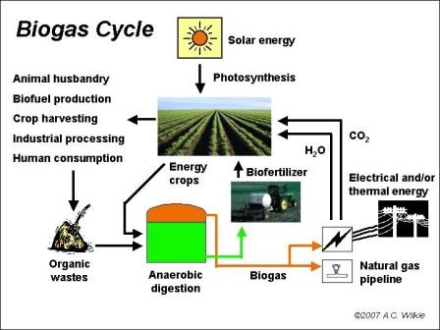

Slide 7
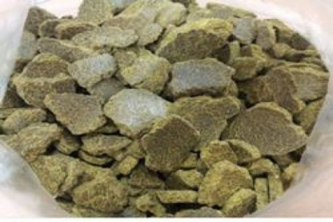
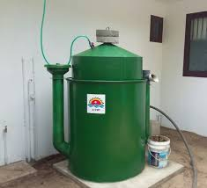
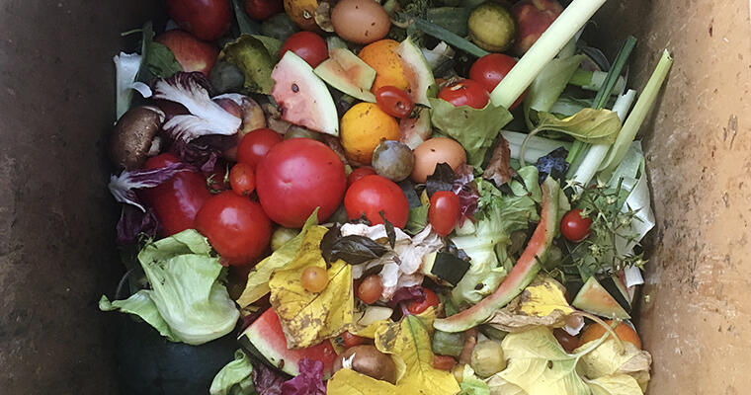
Deoiled cake
Biogas plant
Hostel kitchen waste
Notes:
Deoiled
cake
Glycerol
Biogas plant
Kitchen waste

Slide 8
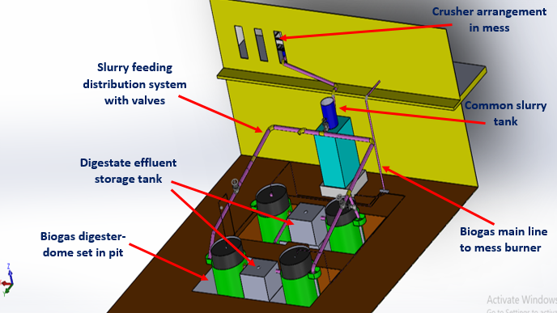
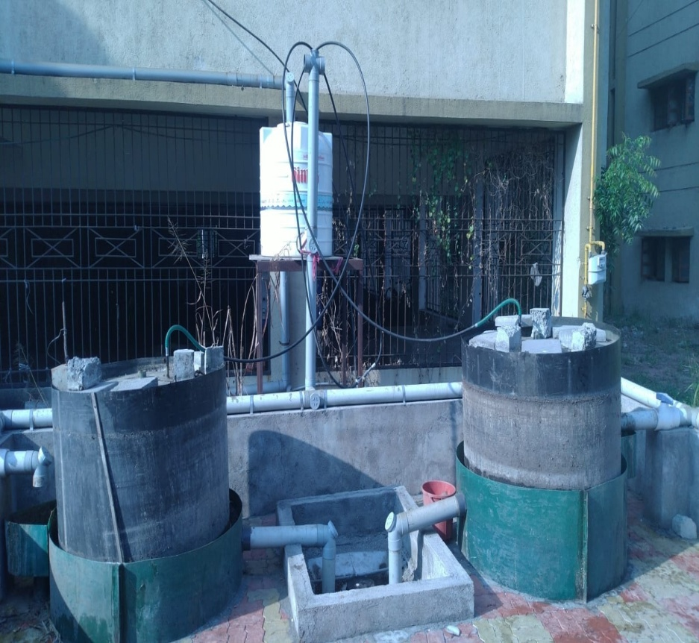
Biogas plant, Near H4 Hostel, SVNIT Surat
Notes:
Biogas plant, Near H4 Hostel, SVNIT Surat

Slide 9
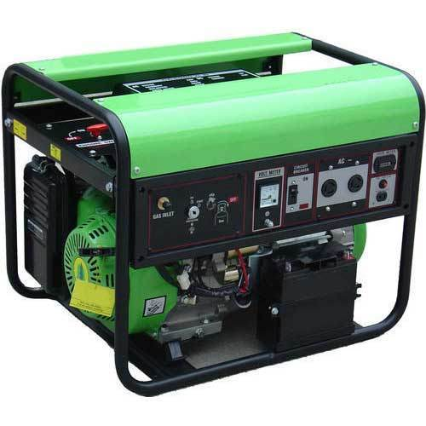
Biogas generator
Notes:
Biogas generator

Slide 10
BIOGAS
Mixture of gases.
Produced by anaerobic digestion of organic matter.
Consist of CH₄, CO₂, traces of H₂ & other gases.

Slide 11
Composition of Biogas
Raw biogas typically consists of :
methane (50–75%),
carbon dioxide (25–50%),
and smaller amounts of nitrogen (2–8%).
Trace levels of hydrogen sulfide, ammonia, hydrogen, and various volatile organic compounds are also present in biogas depending on the feedstock

Slide 12
BENEFITS FROM BIOGAS PLANTS
Used mainly for cooking & lighting purposes.
Used in internal combustion engines to power water pumps & electric generators.
Used as fuel in vapour absorption refrigerators.
Sludge can be used as fertilizers.
Creates less environmental pollution.

Slide 13
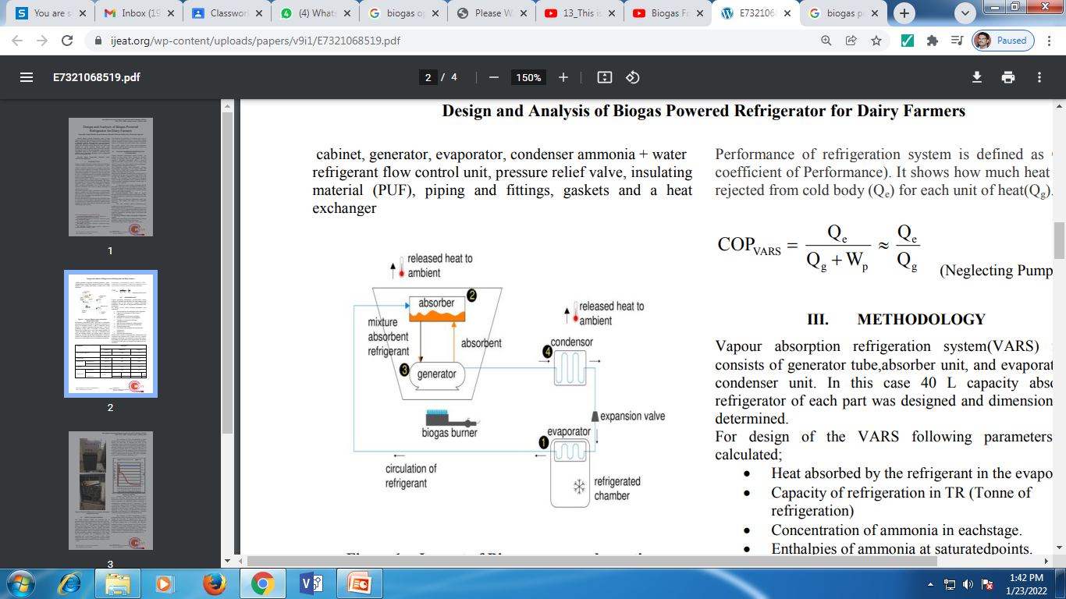
Biogas powered vapor absorption refrigeration system
Reference: https://www.ijeat.org/wp-content/uploads/papers/v9i1/E7321068519.pdf
Notes:
Biogas powered vapor absorption refrigeration system

Slide 14
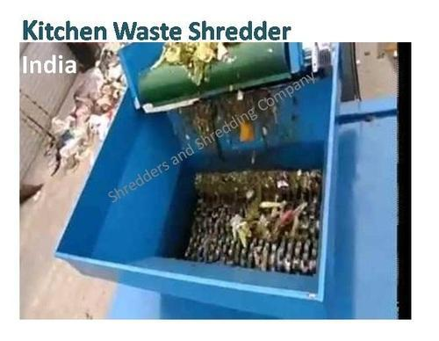
SUBSTRATE
Plant & animal biomass.
Plant biomass –Agricultural wastes.
Animal biomass – cattle dung,manure from poultry, goats & sheep slaughter house & fishery wastes.

Slide 15
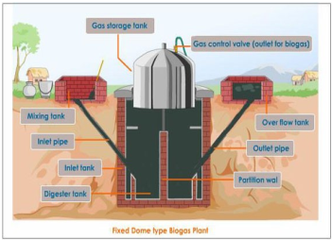
Parts of biogas plant
Digester
Gas holder
Inlet
Outlet

Slide 16
Inlet chamber
To supply cow dung to the digester.
It is made at the ground level so that the cow dung can be poured easily.
Made up of bricks, cement and sand.
The outlet wall of the inlet chamber is made inclined so that the cow dung easily flows to the digester.

Slide 17
Digester
Most important part of biogas plant.
Fermentation takes place - fermentation tank.
Built underground – insulated, airtight
Made up of bricks, sand and cement.
Almost at the middle of the height of digester, two openings are provided on the opposite sides for inflow of fresh cow dung and outflow of used cow dung

Slide 18
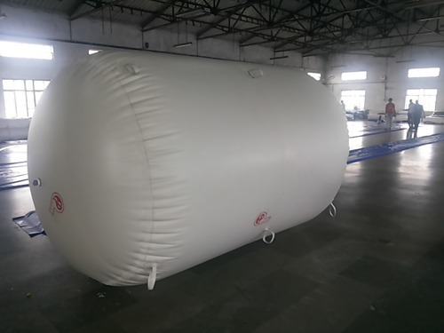
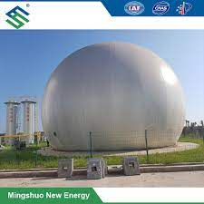
Gas holder
Cylindrical container
Above digester
Collect gas
The gas pipe carries the biogas to the place where it is consumed.

Slide 19
Outlet Chamber
Digested slurry from which the biogas has been generated is removed from the biogas plant.
The outlet chamber is also at the ground level.

Slide 20
Types
GAS HOLDER
Fixed dome type
Floating drum type
FREQUENCY OF FILLING SUBSTRATE
Batch type
Continuous type

Slide 21
Fixed dome type
A fixed-dome plant consists of a digester with a fixed, non-movable gas holder, which sits on top of the digester.
Floating-drum type
Consist of an underground digester and a moving gas-holder.
Gas-holder floats either directly on the fermentation slurry or in a separate water jacket.
The gas is collected in the gas drum, which rises or moves down, according to the amount of gas stored

Slide 22
Batch type
Filled once, sealed.
Emptied when raw materials stop producing gas.
Continuous type
Fed with a definite quantity of wastes at regular intervals
Gas production continuous & regular

Slide 23
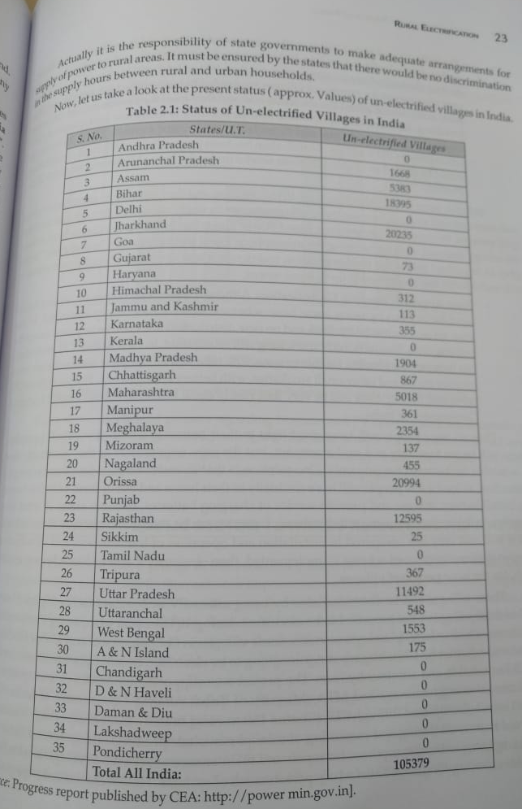
1 lakhs villages are not connected to Grid

Slide 24
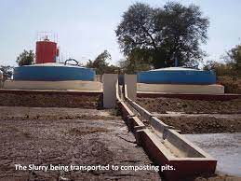
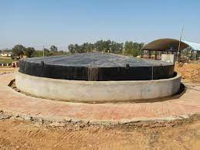
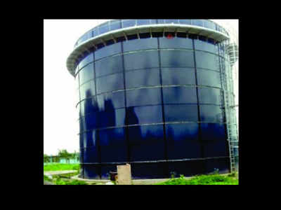
corporation biogas plant
Community biogas plant
individual biogas plant
commercial biogas plant
Notes:
individual biogas plant

Slide 25
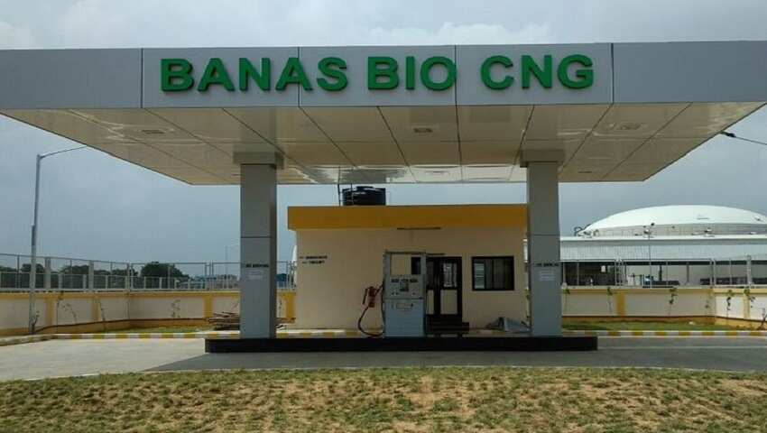
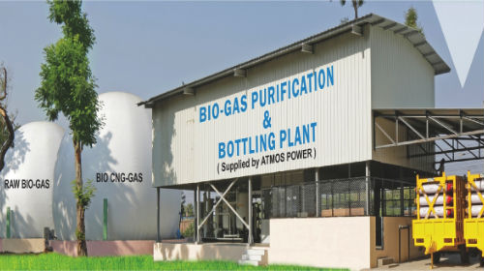
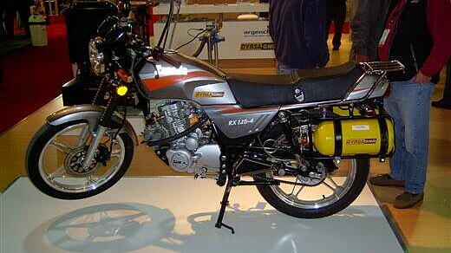
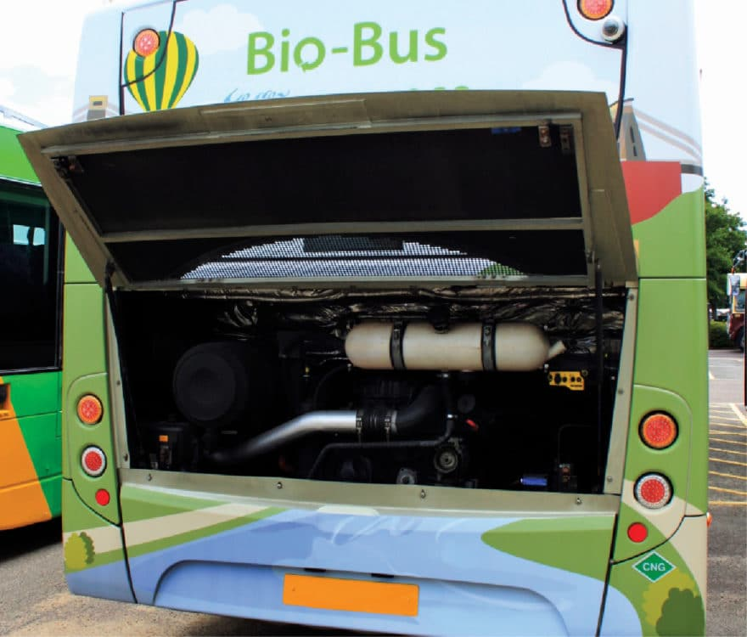
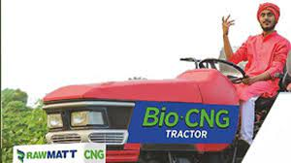

Slide 26
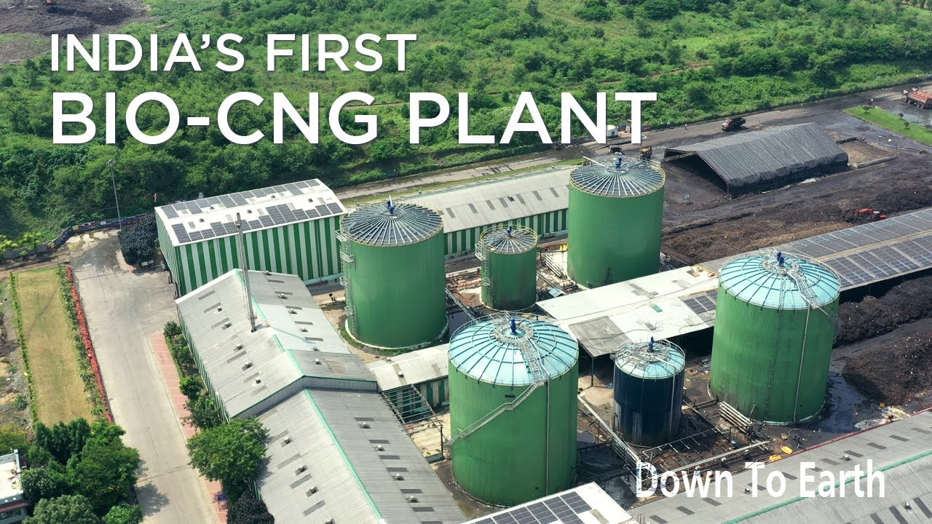

Slide 27
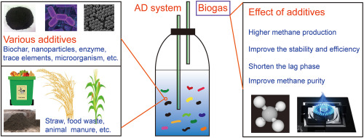
How to improve the Biogas yield
Notes:
How to improve the Biogas yield

Slide 28
Further reading
How to improve the biogas yield?
What do you mean by organic loading rate in biogas plant?
What do you mean by volatile solid, chemical oxygen demand (COD) in biogas plant?
What are the various bio-based/organic materials which can be used for biogas production?
What are the four anaerobic digestion reactions? Explain
(Ans: Hydrolysis, acedogenesis, acetogenesis and methanogenesis)

